Slide 1

The Northern District of Oklahoma Presents . . .
www.oknd.uscourts.gov
2016
Notes:
All information that I share with you today is available in detail on our court’s website.
This is an overview of how CM/ECF works in the Northern District.

Slide 2
What is CM/ECF?
Automated system for case management (CM) and electronic case files (ECF)
Filers can send documents to the court via the Internet, 24 hours a day
Court can send email notices of case activity and court orders to case participants
Notes:
CM/ECF is used by all federal courts in the nation.
Our district has used it since 2005.
Some of the benefits are:
Case access 24 hours a day, every day, with rare exceptions for system maintenance; which means you can also file any time, anywhere you have internet access;
automatic email notices of case activity for any registered user;
And filed document images are immediately available

Slide 3
Getting Started & Registration
CM/ECF Information on Court Website
  Verify Technical Requirements
  Read Administrative Guide of Policies and Procedures
Verify PACER Registration (www.pacer.uscourts.gov)
You must be admitted to the bar of this Court & in good standing or admitted Pro Hac Vice
Completed and signed CM/ECF Registration Form
Notes:
It’s good to become familiar with the our court’s Administrative Guide of Policies and Procedures. Each district court has their own guide.
Review our Civil and Criminal event instructions located on our website.
In addition to registering for CM/ECF you should also have a PACER account. If not, go to the PACER website and register online. The address is shown on the screen.

Slide 4
Updates to Personal Info.
Most personal information can be updated by filer through CM/ECF Utilities
CM/ECF Attorney Information Update form
Registered CM/ECF users receive notice via email and waive conventional service of documents → current email address is imperative
Notes:
While most personal information can be updated directly by you in CM/ECF, the Attorney Information Update form (available on our website) should be used when you need the Court to make changes for you. Such as to update a firm address.
Do this in addition to Filing a Notice of Change of Address in each case.
We do get a bounce back report for failed emails.
We try to verify the email address. If we can’t confirm it, we will delete the email address and turn the account to inactive.

Slide 5
Helpful E-Filing Tips
Until you are comfortable with the system, consider filing your document early on the day it is due.
Review the Administrative Guide located on our website.
Use the event instructions located on our website.
Title your document to match the appropriate CM/ECF event.
DO NOT file a document that should be split into two or more documents. (e.g., Answer and Counterclaim)
  If you have an urgent matter, please contact the appropriate courtroom deputy.
Notes:
If you have ANY efiling questions, during business hours, contact the Clerk’s Office at 918-699-4700.

Slide 6
Technical Information
Filing in Error
  Once a pleading or other paper is submitted, it becomes part of the case
  The attorney may file a motion to withdraw the document, but should not refile the document
  The Clerk’s Office should be immediately notified of any mistakes
Notes:
If you have ANY efiling questions, during business hours, contact the Clerk’s Office at 918-699-4700.

Slide 7
Quality Control - FAQ
Those emails you receive from our Quality Control department….
  If you receive an email regarding an error, note it is only sent as a learning tool.
  The most common errors are the wrong event used, the document contains personal identifiers or the document is signed by one attorney but efiled using another attorney’s login and password.
Notes:
The Clerk’s Office is the keeper of the original court record. If you receive an email from Quality Control regarding an error, it is only provided as a learning tool.
If you have a questions about an email you have received, you may respond to the email or call the Clerk’s Office.

Slide 8
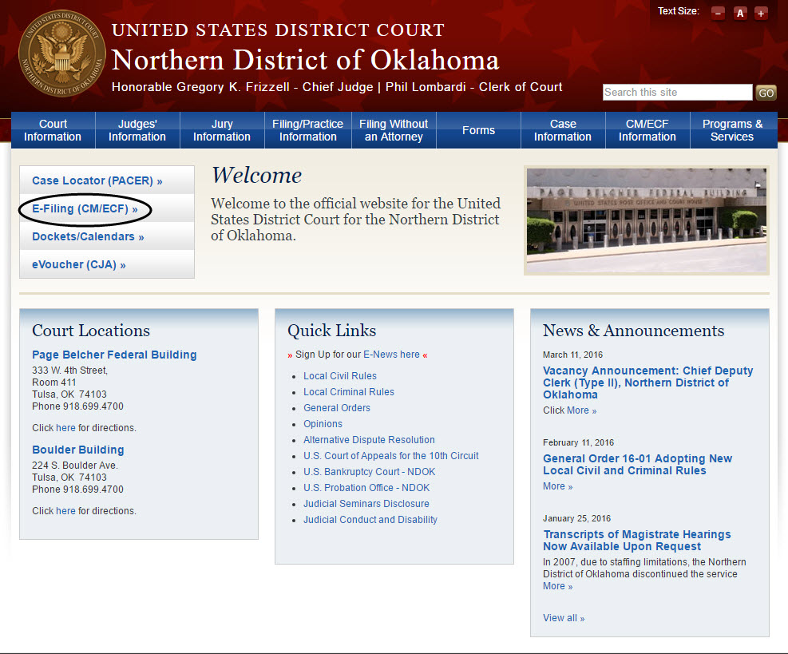
www.oknd.uscourts.gov
Notes:
So let’s go to our court’s website to access CM/ECF. The address is www.oknd.uscourts.gov.
On our homepage is a link to login to CM/ECF. We also have a link to CM/ECF information.

Slide 9
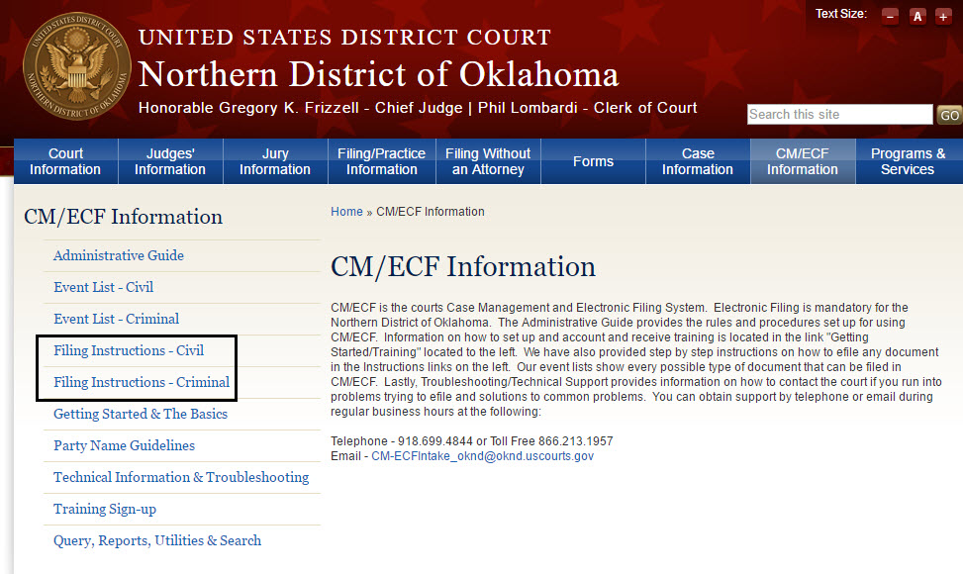
CM/ECF Information
Notes:
The link to CM/ECF information leads us to links for:
the Administrative Guide
Event Filing Instructions
and Technical Information and Troubleshooting,

Slide 10
CM/ECF: Logging In
Notes:
We’ll select the E-Filing CM/ECF link

Slide 11
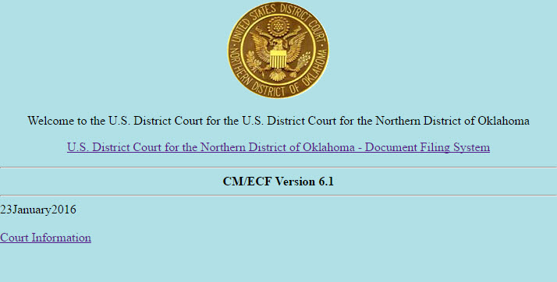
CM/ECF: Logging In
Notes:
On this screen are any Notices of system downtime or upgrades.
To e-file, we’ll click the Document Filing System link.

Slide 12
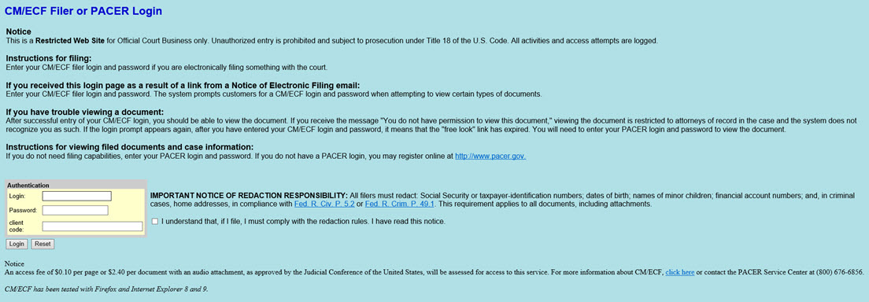
CM/ECF: Logging In
Notes:
This is the login screen for CM/ECF and PACER. Make sure you’re using the correct login for whether you’re filing (CM/ECF) or viewing the case (PACER).
Notice the checkbox next to the login fields. You must check it, which means you agree to comply with the redaction rules, or you won’t be able to log in.

Slide 13
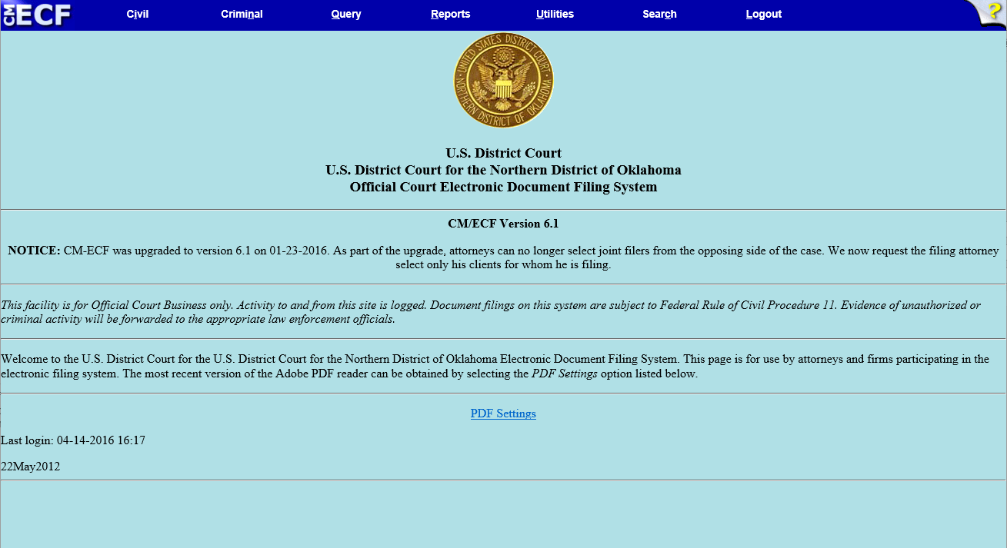
CM/ECF: Main Screen
Notes:
After you’re logged in, you‘ll see the main ECF screen.
You can stay logged in but inactive for up to 30 minutes before the system will “time out”.
This is a security precaution.

Slide 14
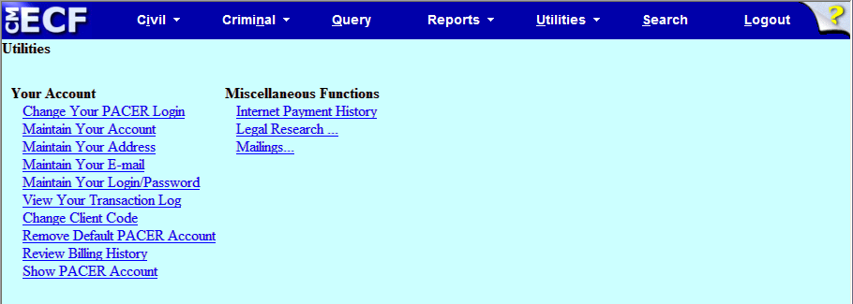

Utilities
Menu Screen
Notes:
Next across the blue bar is Utilities.
If you see Civil & Criminal across the blue bar you are in CM/ECF. If you only see Query & Reports you are in PACER.
Most of your personal information can be updated through
Maintain Your Account
Maintain Your Address
Maintain Your E-mail, and
Maintain Your Login/Password

Slide 15
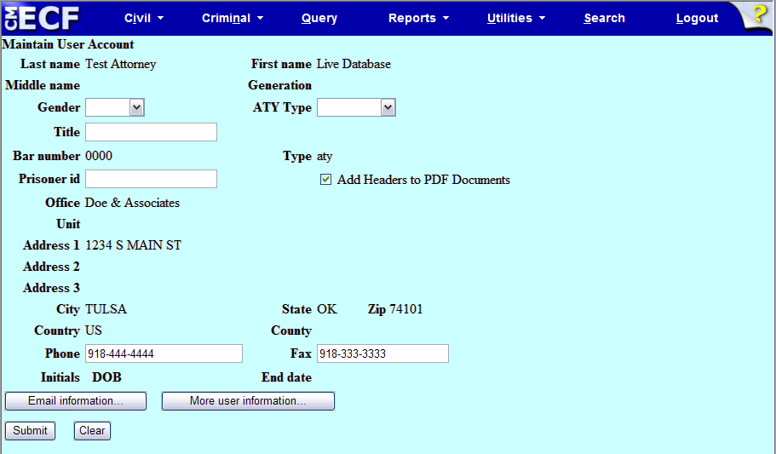
Maintain Your Account
Maintain User Account Screen
Notes:
For address changes, solo practitioners can select Maintain Your Account.
However, firm address changes must be made by submitting an Attorney Information Update Form. That form is available on our website.
Click Email Information . . . (at the bottom of the screen)

Slide 16
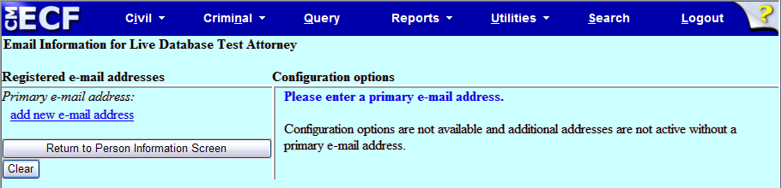
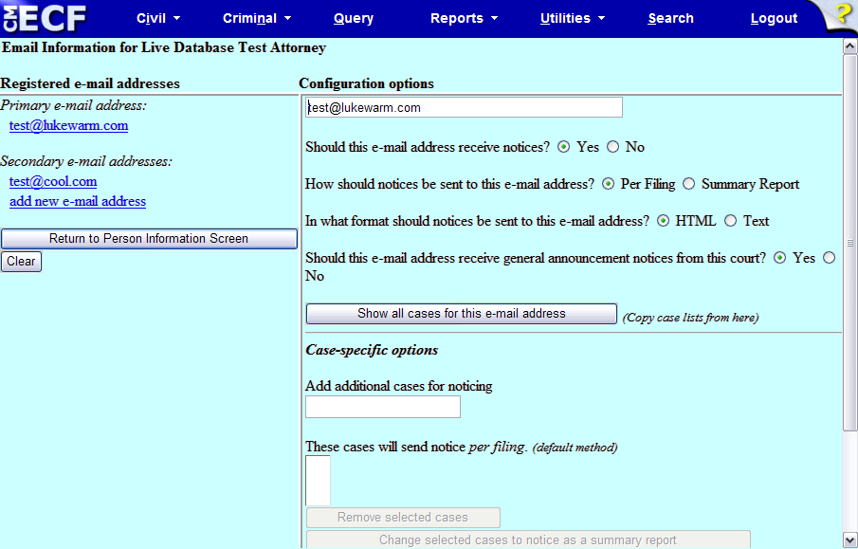
Maintain Your Account
1
Email Information Screen
2
Notes:
To view and change your primary email address or add or change your secondary email addresses.
We recommended listing a secondary email address from a different service provider. For example, if you have an email address with your law firm, set up an email account with yahoo, cox , google , etc.
Then, if your primary service provider fails, you will still have a way of getting notices of case activity.
If you want to change your password please note the Court will not have access to it. However, if you forget what the password is we will reset it back to the original password.
And then click “Return to Person Info Screen”
When you are done select Submit

Slide 17
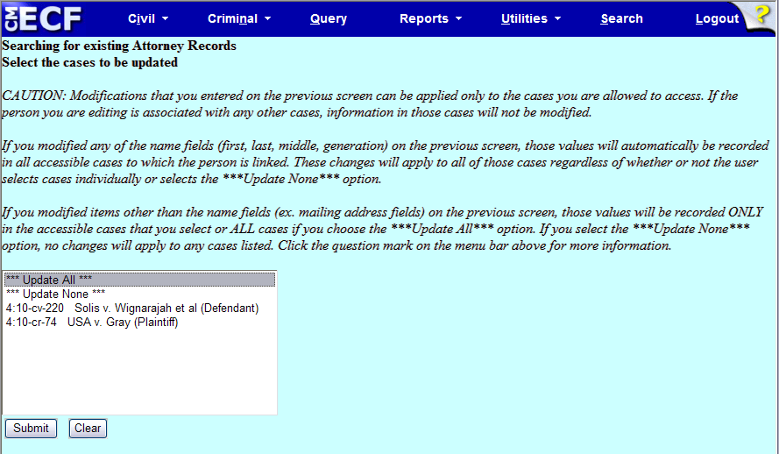
Maintain Your Account
Case Update Screen
Notes:
We get the case update screen– please leave “Update All” highlighted if you want your changes to take effect globally, and click “Submit” again.

Slide 18
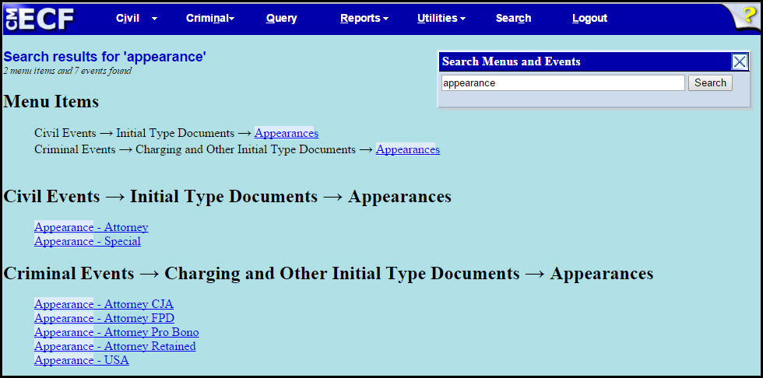
CM/ECF: Universal Search Utility
Notes:
With your document converted to PDF, it’s ready to file.
If you are not sure what event is available, click Search on the blue menu bar in CM/ECF to access the Universal Search Utility.
Or use our event lists.

Slide 19
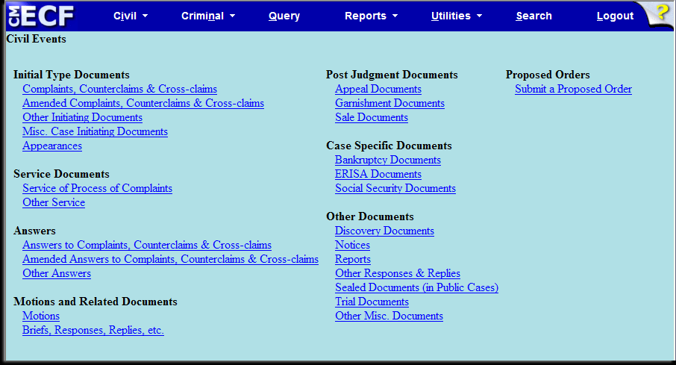
CM/ECF: Civil Menu
Notes:
Click Civil on the blue bar, to view the Civil Events menu.
Our event lists and e-filing instructions follow the same order as the CM/ECF menu screens. This makes event information easier to locate.
And we frequently update the event lists and instructions so the latest versions are always available on our website. If you can’t find your specific event try to find one similar.
If you really can’t find one, call the help desk and we’ll tell you what to use.
We’re going to file the Entry of Appearance.
Most event instructions have a “Rules for Use” section which indicates when the event should be used.
Below that are Before Filing instructions , which include reminders about personal identifiers, having a current Certificate of Service, following the 7.1 Disclosure Statement rule and remembering the 20 megabyte file size limit.
The instructions tell us, Under Initial Type Documents, to select “Appearances”.

Slide 20
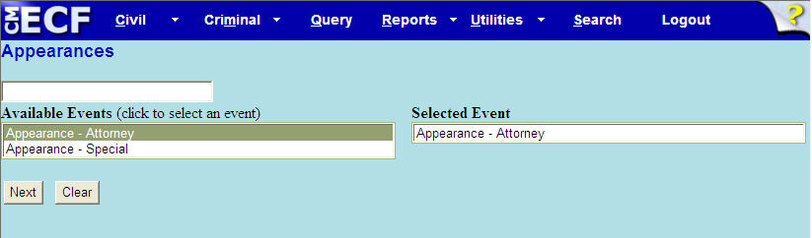
Entry of Appearance
Appearances Screen
Notes:
From this screen we can select any available “Appearance” events.
If you know the event name, you can start typing it in the top box – and the event list will be narrowed by the criteria you’ve entered.
Or click on the drop down box and select “Appearance - Attorney”
Then, “Appearance – Attorney” will listed on the right in the Selected event box.
Click Next.

Slide 21
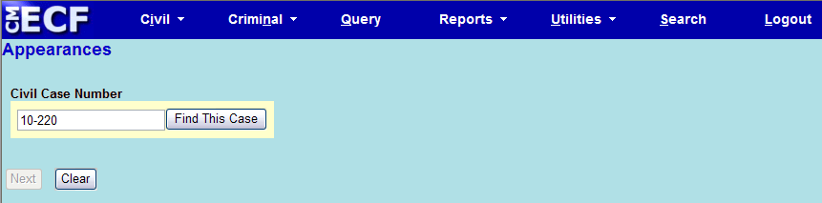
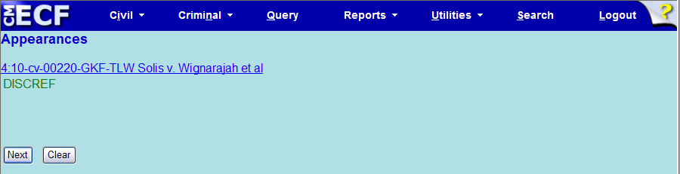
Entry of Appearance
1
Case Number Screen
2
Case Style Screen
Notes:
Next, on the case number screen, enter the case number.
On the Case style screen confirm the case number matches the style of the case. In our case number example ,
4 is the Divisional office;
10 is the year;
CV is for civil;
220 is the assigned number;
GKF is for Judge Frizzell and
TLW is for Magistrate Judge Wilson, the assigned discovery magistrate.
Always make sure the case number on your document includes the correct judges.
As a side note, the case number is an active link to the docket sheet, after you log into PACER
And we’ll click “Next” again.

Slide 22
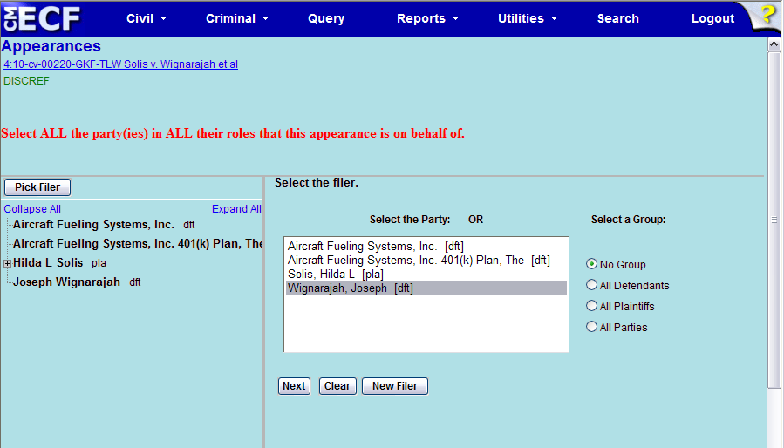
Entry of Appearance
Select Filer Screen
Notes:
The case participant tree on the left side of the screen lists all case participants. This is only for reference.
On the right side of the screen you can select from existing parties.
Do not click the browser Back button when you’re on a divided screen like this one. Data is not saved until you complete the docketing process; and clicking the Back button will cause all progress to be lost.
If you realize you have made a mistake in any entry, just go up to the blue bar utility and select Civil or Criminal to “bail” out.
Since this is an entry of appearance we should select the party in ALL their roles, such as counterclaimant or crossclaimant.
And click Next.

Slide 23
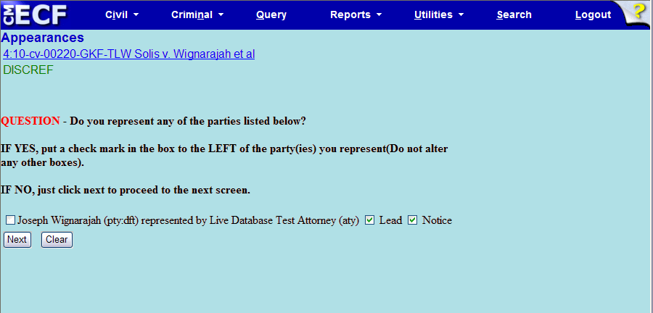
Entry of Appearance
Attorney/Party Association Screen
Notes:
This screen is important –it’s where you create your attorney/party association. If you do not create this association, you will NOT be added to the case, or receive electronic service.
Do you represent any of the parties listed?
If yes, check the box to the left of them
If no, click next.
Also, always leave the Lead and Notice boxes on the right alone. These boxes are checked by default because in our court everyone is lead counsel and everyone should receive Notice.
And click Next

Slide 24
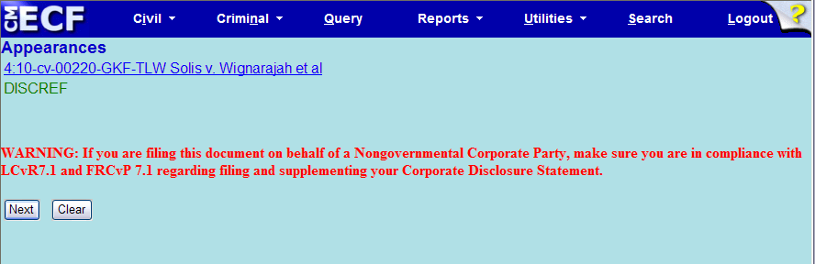
Entry of Appearance
Corporate Disclosure Warning Screen
Notes:
We have several warning screens you may see while e-filing. This one reminds filers of the requirements regarding corporate disclosure statements.
And click Next

Slide 25
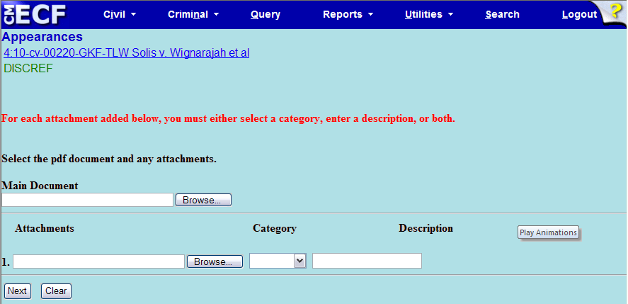
Entry of Appearance
Upload PDF Screen
Notes:
On this screen filers add the main document and attachments , if there are any
The first step is to click “Browse”
We have a 20 mg limit for a single pdf.

Slide 26
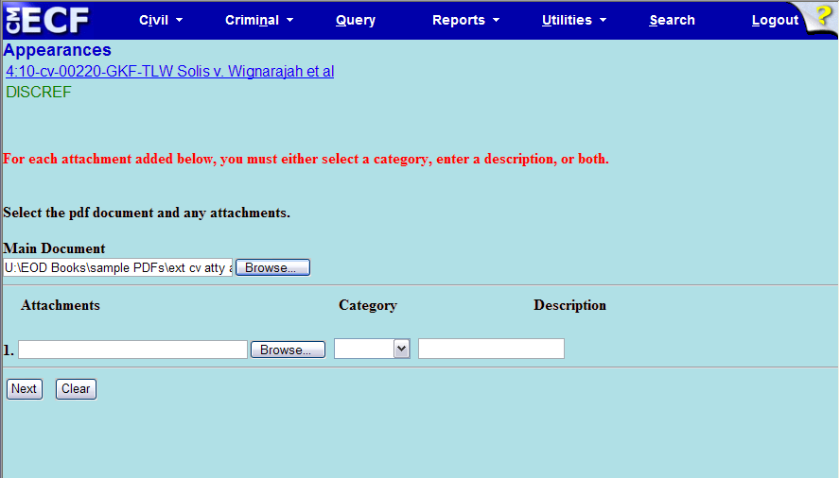
Entry of Appearance
Attach PDF Screen
Notes:
By clicking Open, we are returned to CM/ECF and the file name and location are copied into the Main Document field.
If there were attachments to the main document you would add the first attachment, then a new row would appear so you could then add a second attachment if needed, and so on.
If you noticed on this screen that the main document filename or location or attachment filename or location were incorrect, you would click Browse again and load the correct document, replacing the incorrect one.
And if you click Clear after adding documents and attachments, the screen is returned to the default state.
But, we chose the correct document and there are no attachments, so we’ll click Next.

Slide 27
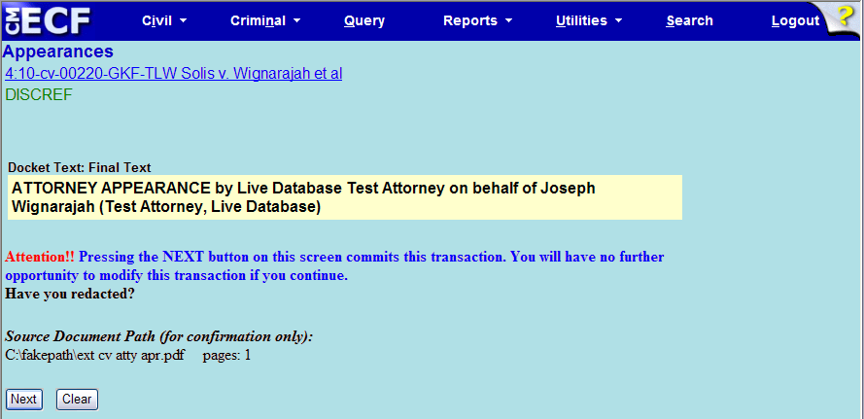
Entry of Appearance
Final Text Screen
Notes:
Here is the final text screen. Our last chance to cancel the entry and start over. Review the entry carefully.
The full path and filename for any uploaded documents are displayed on this screen.
If changes were required, we would need to start over by clicking “Civil” on the blue bar.
We like it the way it is, so we’ll click Next to submit the document.
Filers need to stay on this screen until the Notice of Electronic Filing, or NEF, is displayed.

Slide 28
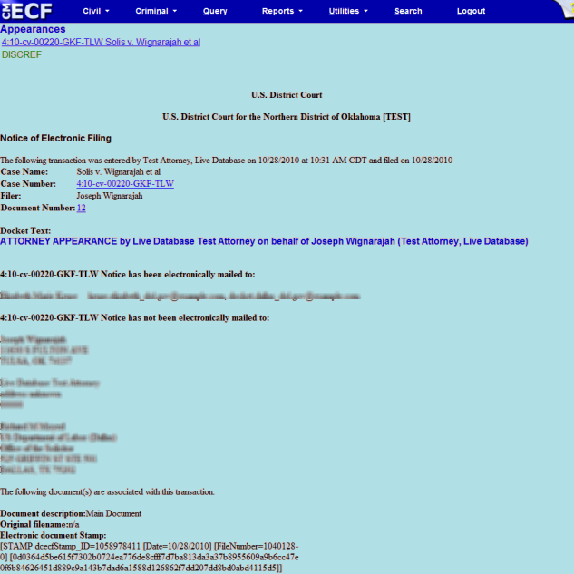
Entry of Appearance
NEF Screen
Notes:
This is the NEF. Let me show you what it contains.
At the top of the page are the docket text, date and time, case name, number, filer and document number.
If you have filed a motion you’ll need to add the docket number to the Proposed Order you’re going to email to us.
Below that is a list of who will receive notice by electronic means and who you will need to manually serve.
And the electronic document stamp appears at the bottom of the screen.
You’ll also get an email notice with a link to the filing that allows you to view it for free within 15 days. This is often referred to as the “free look.”

Slide 29

CM/ECF: Civil Menu
Notes:
Next we’ll file a motion in limine.
From the civil menu, Under Motions and Related Documents, select Motions

Slide 30
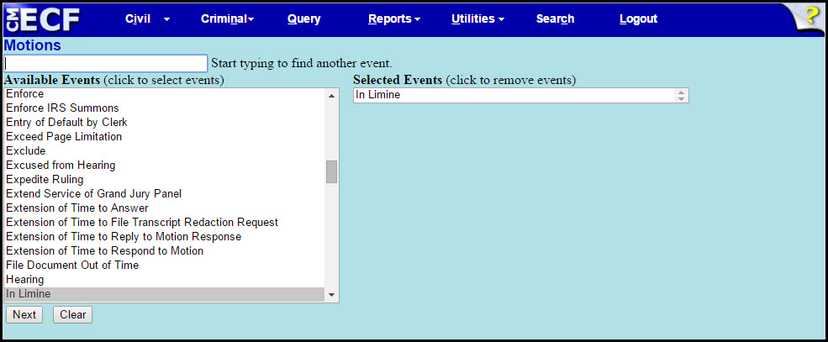
Motion In Limine
Motions Screen
Notes:
On the Motion Screen, you can find the motion relief by doing the “Docket Event Search”.
Although I have told you not to combine documents, you CAN combine motion reliefs. We do ask that you make sure that the motion reliefs are related.
And be sure to select each relief in CM/ECF that you requested within your motion.
CM/ECF will still treat each selected relief as its own motion even though multiple reliefs are chosen within one filing. The Court will then have the ability to rule on each motion relief individually.
Click Next

Slide 31
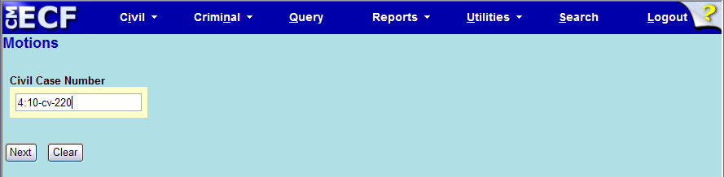
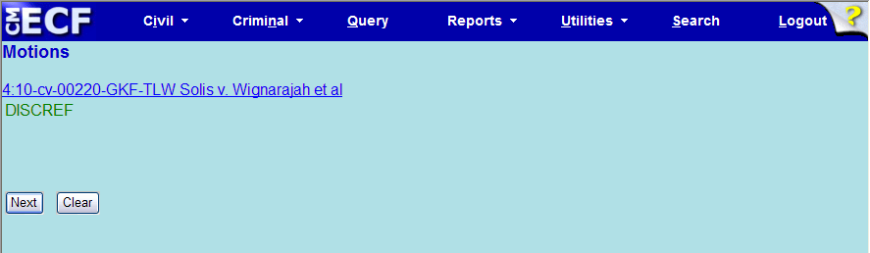
Motion In Limine
Case Number Screen
Case Style Screen
Notes:
Again, enter and confirm the correct case number and click Next.
Confirm the case style and click Next.

Slide 32
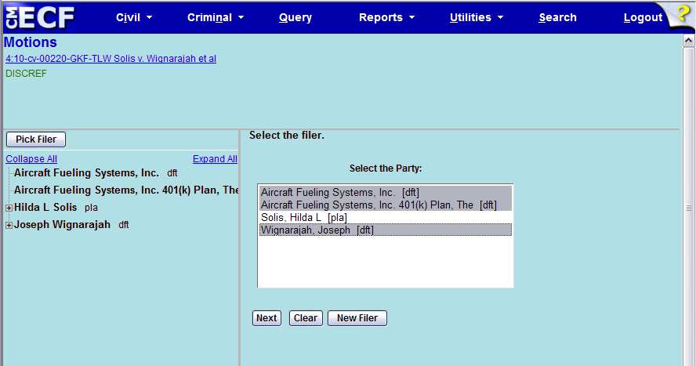
Motion In Limine
Select Filer Screen
Notes:
This time we’re filing a Motion in Limine by all defendants so we’ll select all defendants and click Next.
There are 3 ways to select multiple filers:
If sequential,
click and hold the mouse on the first one and drag the mouse to the last one or
click the mouse on the first one and while pressing the Shift button, click the mouse on the last one.
If non-sequential,
you can hold the Ctrl button and click to highlight the ones you want.
After you have them highlighted, click next.

Slide 33
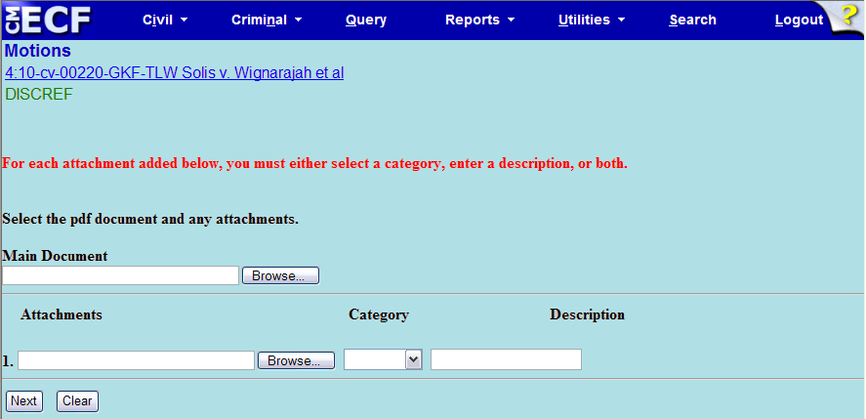
Motion In Limine
Attach PDF Screen
Notes:
It’s time to upload the PDF.

Slide 34
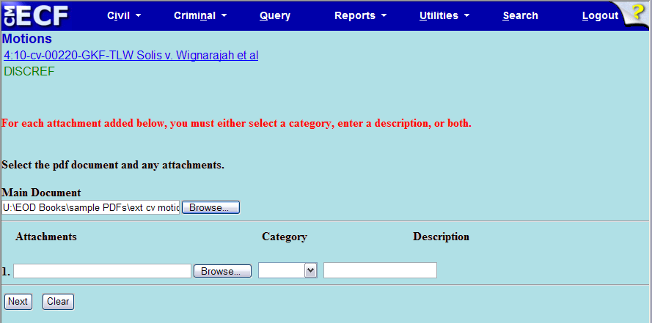
Motion In Limine
Attach PDF Screen
Notes:
This time, after we have uploaded the main document, we’re also going to upload an attachment, so we’ll click Browse in the Attachments section.

Slide 35
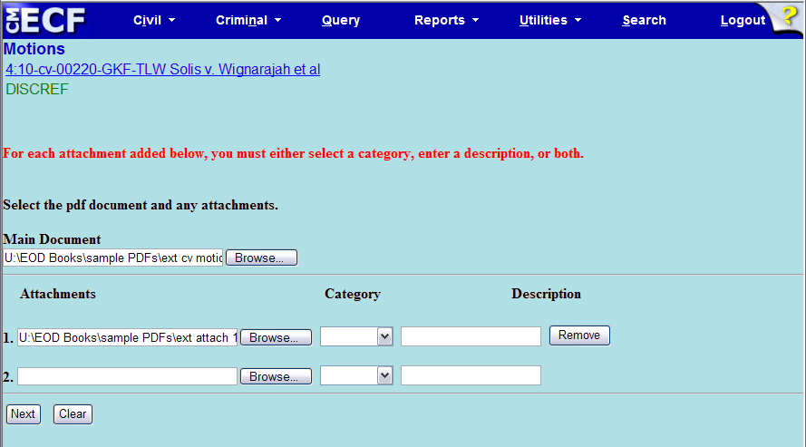
Motion In Limine
Attachments Screen
Notes:
Now the file name and location of the attachment are listed in the first attachment field.

Slide 36
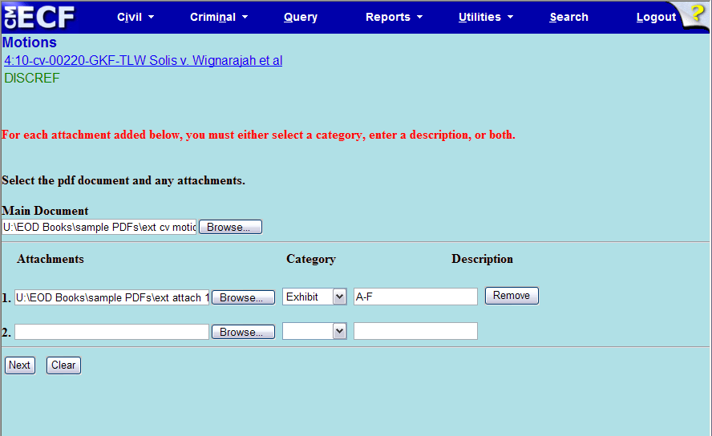
Motion In Limine
Attachments Screen
Notes:
When you add an attachment to a document when e-filing, you must either select a category or enter a description, or both, before continuing.
You can combine exhibits into one attachment as long as each attachment is less than 20 megabytes. If a PDF does exceed the 20 MB limit, it must be split into smaller PDFs. Although the Court has no maximum limit for the total file size of a docket entry, the total file size may be limited by the upload speed of your internet connection. If your system “times out” while you are uploading PDFs into CM/ECF, you will need to break up your filing into more than one docket entry.
Notice that a new row appears after adding the first attachment, so a second attachment can be added, and so on.
We’re only uploading one attachment so we’ll leave the second row blank and click Next.

Slide 37
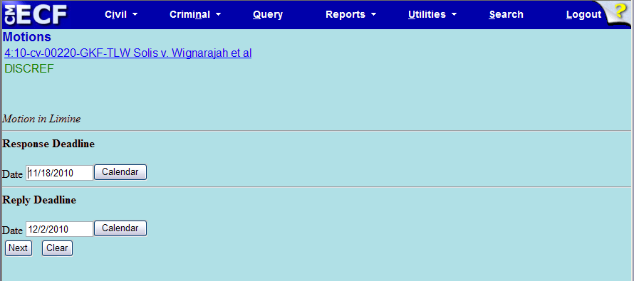
Motion In Limine
Response/Reply Deadlines Screen
Notes:
On all motions, you will get a Response and Reply deadline screen.
If you selected more than one motion relief for this entry, you will get multiple Response and Reply deadline screens.
Do not change or rely on these deadlines.
Just click Next to get past them.

Slide 38
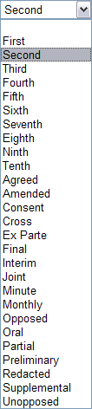
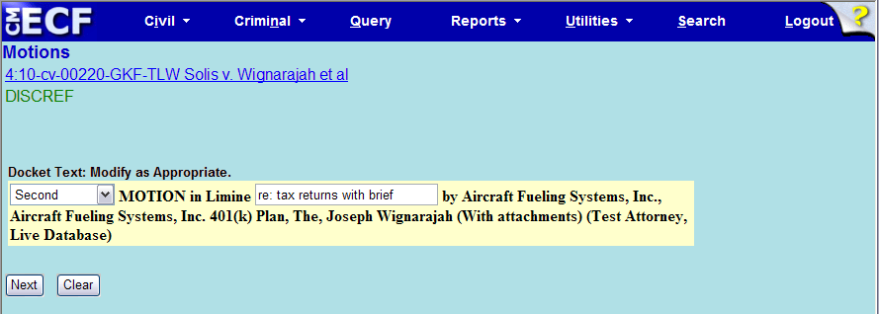
Motion In Limine
Modify Text Screen
Notes:
On some events you will see text boxes.
On our website we have guidelines for modifying the text for an event.
The first box is called a prefix box. Click the arrow to view prefix options. Make sure your document is titled with the same prefix, if you select one.
The second box is a free text box. Here you can enter a short description. As an example, for a Motion to Strike Hearings/Deadlines, you might add what you want to strike, such as Discovery Deadline or Pretrial Conference.
Also, if you have included the brief in support within the motion you would type “with brief”.

Slide 39
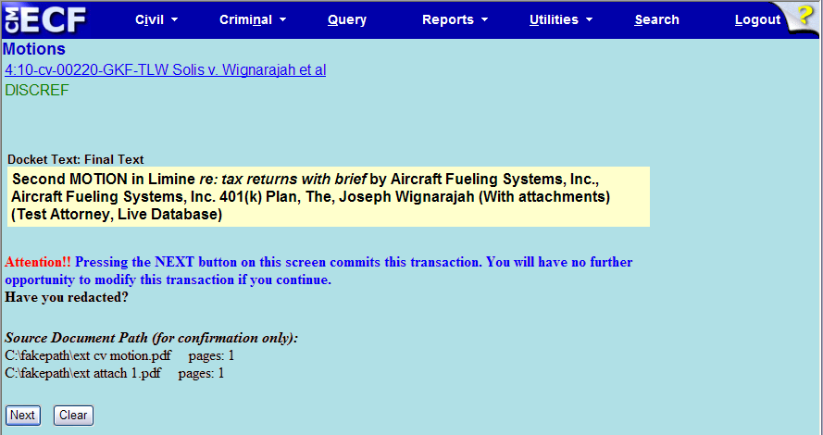
Motion In Limine
Final Text Screen
Notes:
This is the final text screen. The information we added in the free text box is in italics so you know what you’ve added.
Also, the entry says “with attachments” because we uploaded an attachment to our main document.
This filing looks fine so we’ll click Next.

Slide 40
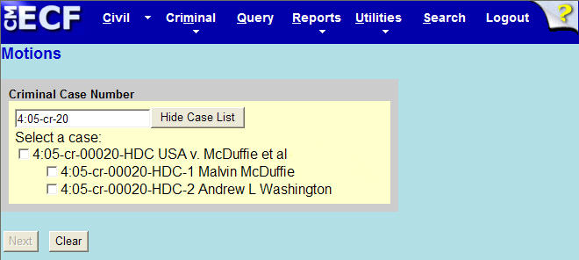
E-Filing in Criminal Cases
Case/Defendant Selection Screen
Notes:
Does anyone plan to do any criminal filings? The main difference between civil and criminal filing is that criminal cases are made up of one or more defendant cases – one for each defendant in the case. So, if it is a multi-defendant case you’ll need to select all the defendants the filing relates to. It causes a great deal of behind the scenes editing to fix the “as to” defendants in a case.

Slide 41
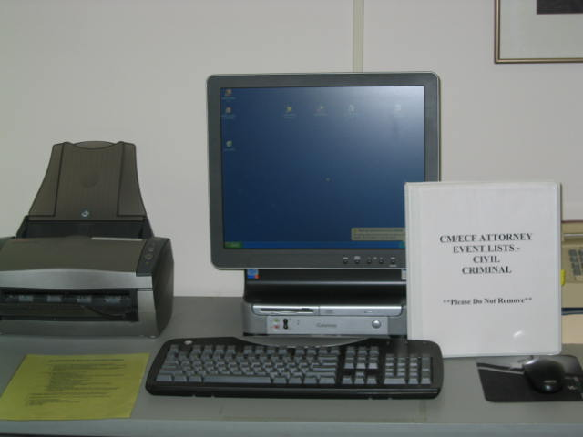
End User Support
We’re here
to help!
918-699-4844 or
866-213-1957 (toll free)
CM-ECFIntake_OKND@oknd.uscourts.gov
Notes:
We’re here to help.
In addition to our help desk and our online instructions, we have a public scanning station in the clerk’s office.
Bring your login and password and your document (paper, disk, cd, thumb drive) and we can help you convert your document to PDF, if needed, and file it into CM/ECF.

